Slide 1

NYC
Accidents
*0
XX
By: Mohammad Salem

Slide 2
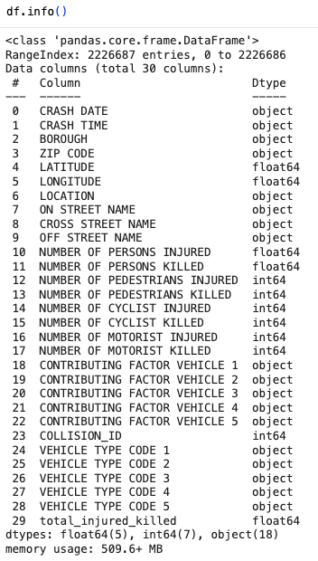
Data Description
This is a dataset from data.gov
https://catalog.data.gov/dataset/motor-vehicle-collisions-crashes
It is a table of >2M records that contains information from all police reported motor vehicle collisions in NYC where there was > $1000 in damage or there was a fatality/injury involved.
There are 29 columns given,
We keep as much attributes as possible, each record includes location info, contributing factors, result of accident (fatal/injury), vehicle type.
Data tracked since mid 2012 to today.

Slide 3
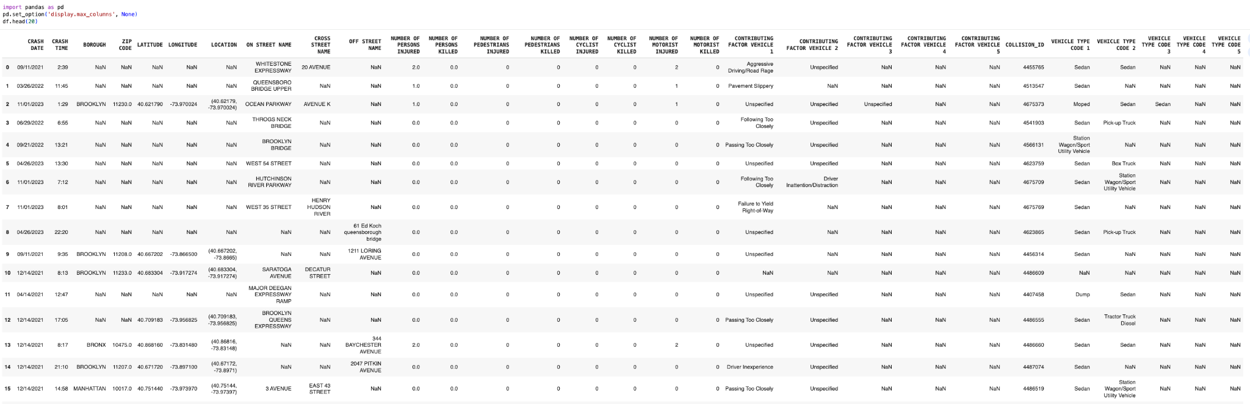
Data Description - head

Slide 4
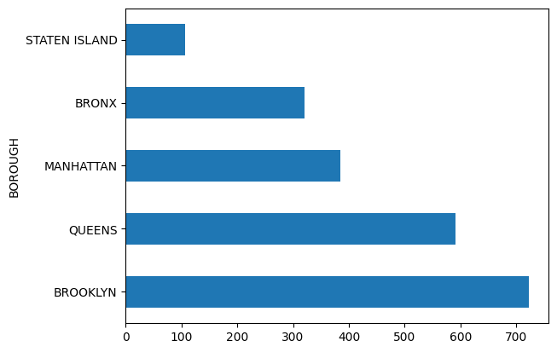
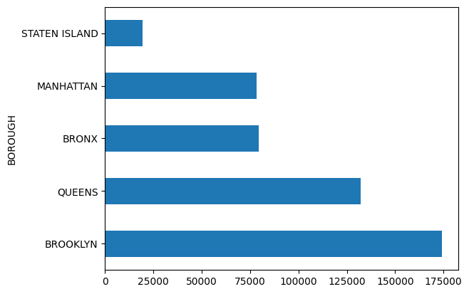
Visualizations
Total Number of Fatalities by Borough
Total Number of Injured by Borough
Brooklyn records the highest numbers for both accidents resulting in injuries and fatal accidents.
A significantly higher number of accidents result in injuries compared to fatalities.

Slide 5
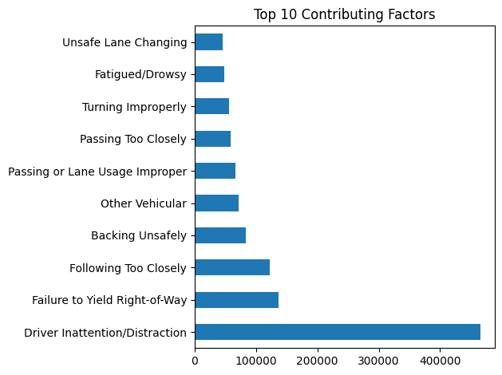
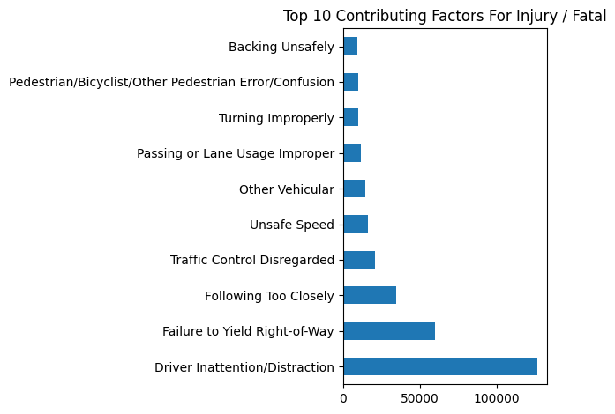
Visualizations
Driver Inattention is the leading cause of accidents, followed by failure to yield and following too closely.
The top five factors contributing to accidents resulting in harm are similar to the overall accident factors.
However, driver inattention is a significantly stronger causal factor in all accidents compared to only those resulting in harm.

Slide 6
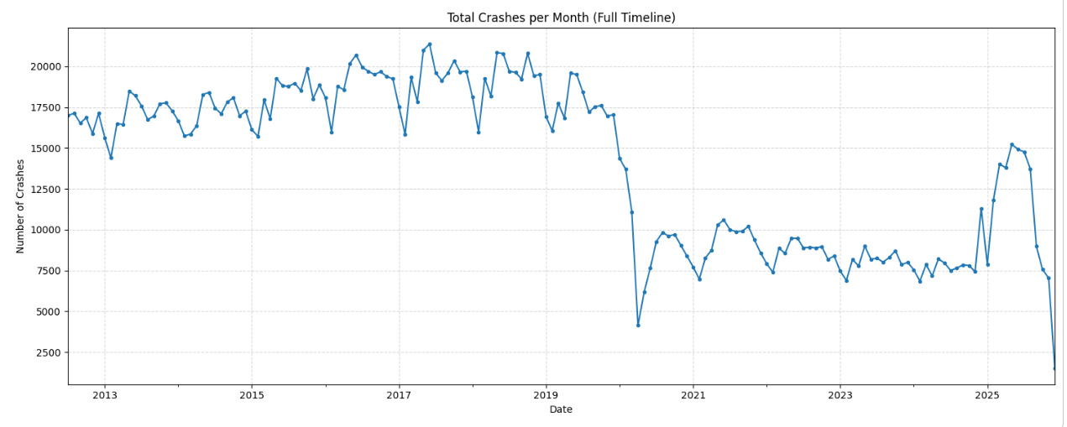
Visualizations
Significant Dip in Accidents around time of covid, also likely did not recover due to Vision Zero NYC initiative, and possibly remote work.

Slide 7
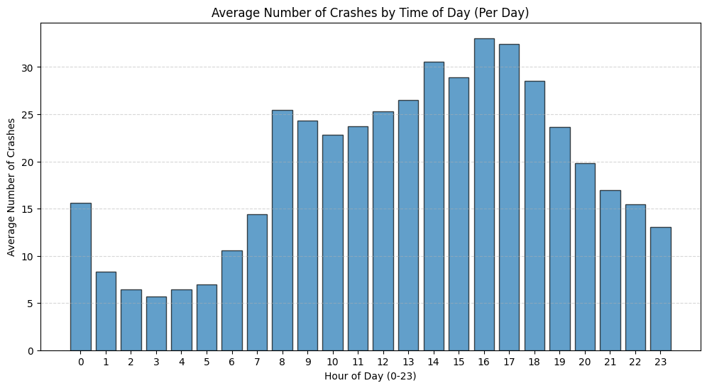
Visualizations
Accidents usually occur during rush hours (going to and leaving work). With 4-6pm Being the time where most accidents occur (leaving work).

Slide 8
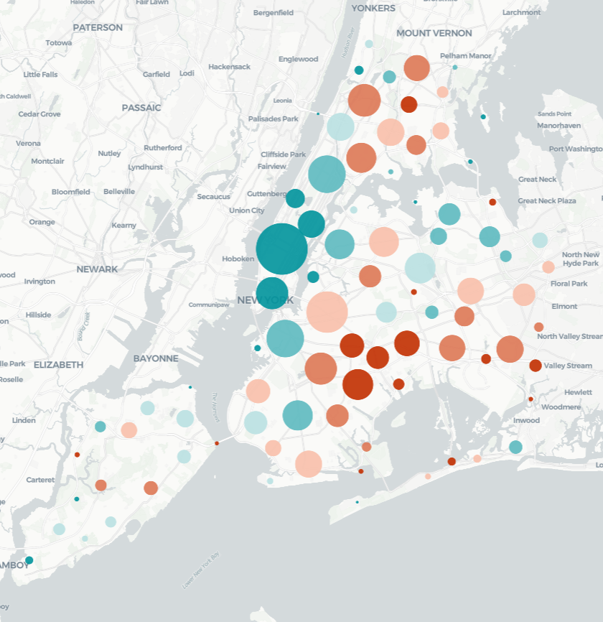
Visualizations
Cluster Map
The core of NYC (Manhattan) has much more accidents but don't typical end up with injuries
East Brooklyn has less accidents but end up with injuries more often
Manhattan Area has about 4k accidents with 1/4 accidents resulting in injuries.
East Brooklyn has about 1.5k accidents with 1/2 accidents resulting in injuries
Size = # of Accidents
Color = Injury Rate Blue(Low) -> Red(High)

Slide 9
Goals
Preprocess
Models
Evaluation
Convert Time to groups, e.g. afternoon, clear na’s if needed for the particular model, keep as much data as possible.
Attempt Apriori to find ordinal/co-occurrence patterns.
Use K-means to find grouped patterns, e.g. Cluster of Aggressive drivers resulting in injuries.
Assess Apriori using Support, Confidence, and Lift to determine pattern strength.
Evaluate K-Means clustering with the Silhouette Score to ensure meaningful cluster separation.

Slide 10
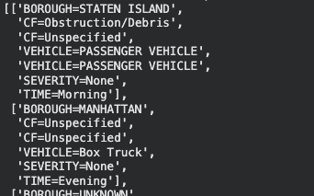
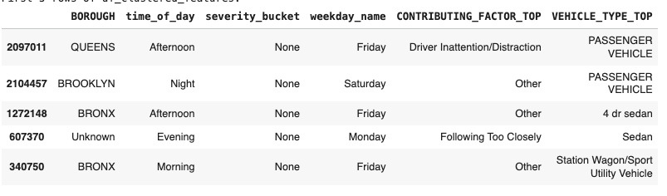
Pre-Processing Done
Apriori
K-Means
Due to Computational Constraints 1/4 of data was sampled (500k records)
Encoding into transactions;
Missing borough -> “Unknown”
Extract Contributing Factors
Extract Vehicle Types
Create Severity (i.e. 0 -> “None”, 1-2 -> “Low”, etc.)
Time Buckets (i.e. 00-06 -> Night)
One-Hot Encoding of transactions
Result
Selected Important columns
Time to category (i.e. morning, afternoon,etc)
Severity; injury/fatalities into categories like none, hi, mid, low
Dates converted to weekday
Used only top 10 factors and vehicle types, otherwise uses “Other”.
Missing borough filled with “Unknown”
One-Hot Encoding
StandardScaler to make all categories weigh equally.
Result (before one-hot encoding):

Slide 11
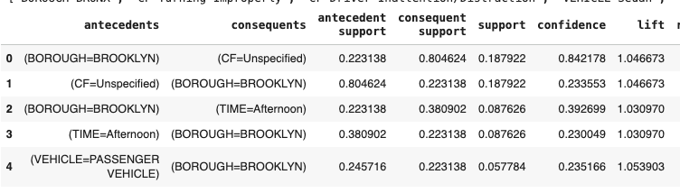
Model
Apriori
Using Apriori we resulted in decision tree like results, due to the way the transactions were encoded.
The model produced valid but weak associations due to dataset imbalance.
In our results all roads lead to brooklyn, likely due to the heavy amount of brooklyn accidents. The same for afternoon accidents.
This shows that the dataset is dominated by Brooklyn, passenger vehicle accidents in the afternoon. The relationships are driven by frequency more than associations. Apriori isn’t well suited for this encoding.

Slide 12
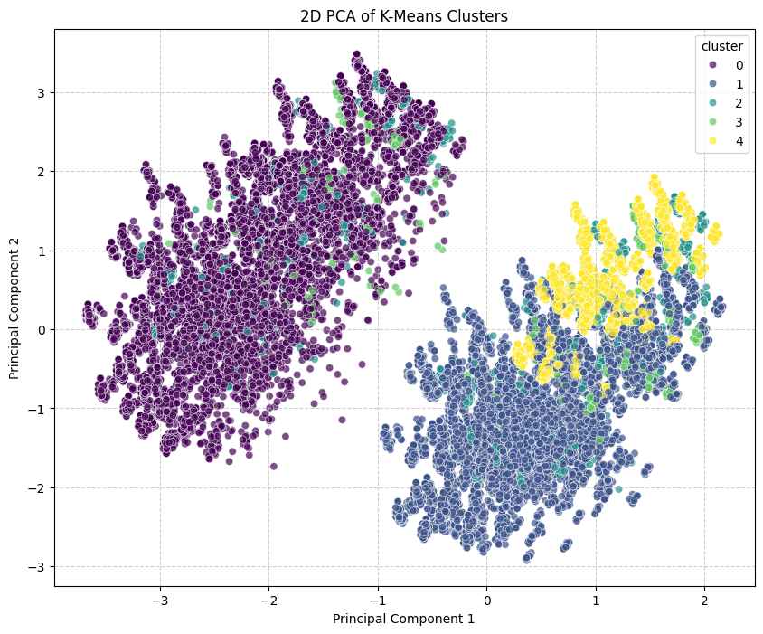
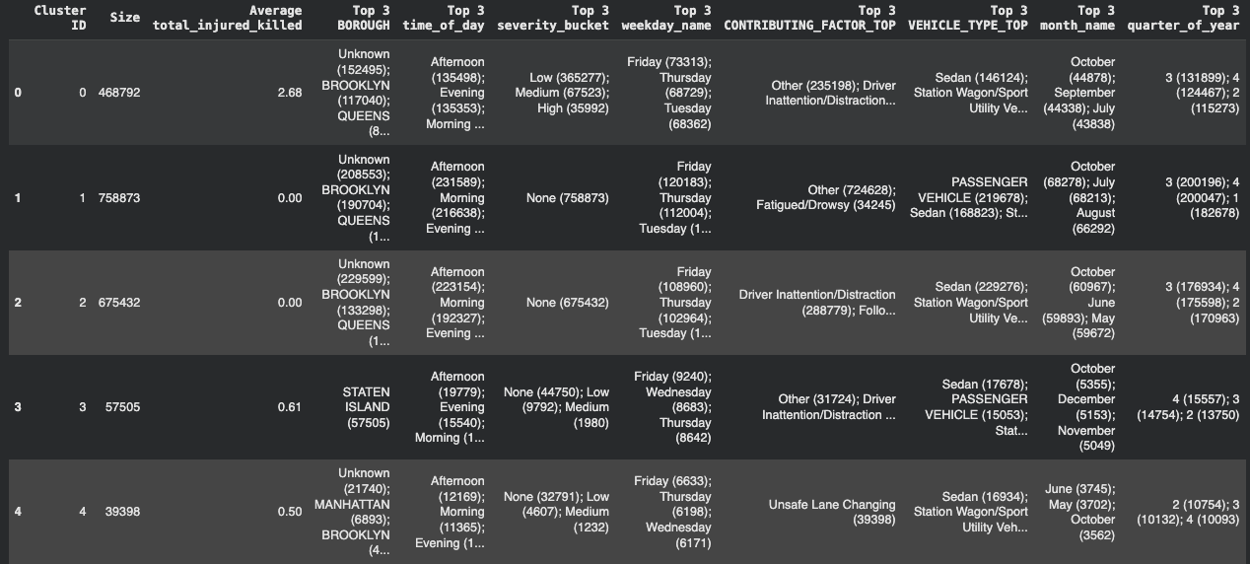
Model
K-Means (k=5)
Cluster 0; (Severe Crashes): Highest injuries/fatalities (~2.7 per crash), mainly medium/high severity, often due to failure to yield at intersections, peaking in the evening.
Cluster 1; (Fender Benders): High volume, no injuries; mostly rear-end crashes from inattention or following too closely.
Cluster 2; (Staten Island): All crashes occur in Staten Island with moderate injury risk (~0.6), reflecting its unique driving environment.
Cluster 3; (Manhattan Taxis): Taxi-only crashes in Manhattan with moderate injury risk (~0.5), shaped by dense urban traffic and taxi behavior.
Cluster 4; (Minor/Unspecified): No-injury crashes with vague causes, likely minor incidents with limited reporting.
Silhouette score isn’t good @ 0.048, indicating weak separation. But Clusters still came with interesting finds.

Slide 13
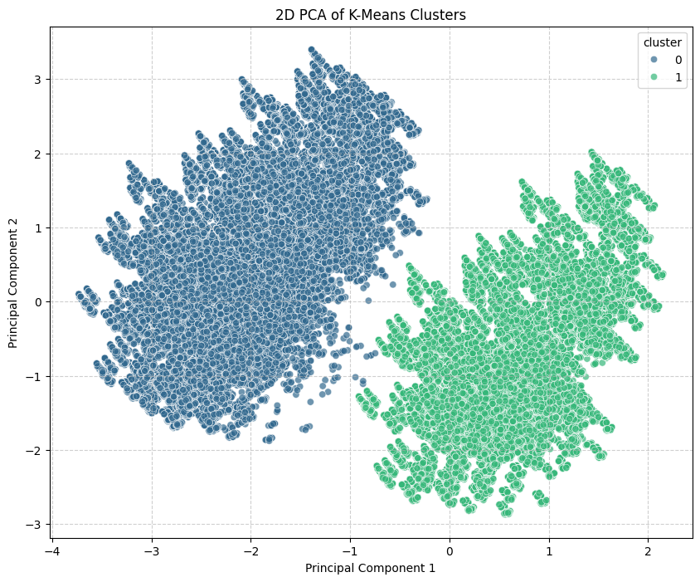
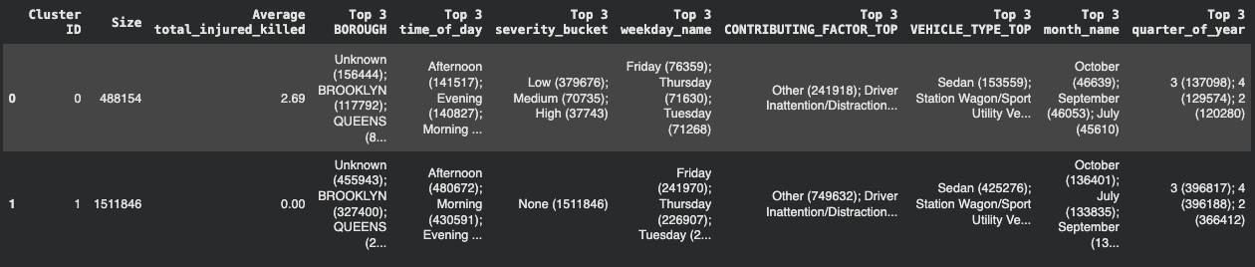
Model
K-Means (k=2)
Silhouette Score little higher but still low @ 0.079
PCA clusters looks more natural though
Cluster 0 (Harmful crashes): Less frequent but higher impact crashes that result in injuries or fatalities, often occurring in the afternoon or evening, toward the end of the workweek, mainly in Brooklyn and Queens, and commonly involving driver inattention and sedans or SUVs.
Cluster 1 (Harmless crashes): The majority of crashes, occurring during weekday commuting hours, spread across boroughs, involving similar vehicles and contributing factors, but resulting in property damage only with no reported injuries.

Slide 14
NYC
Accidents
Conclusion
NYC crash data shows clear patterns by borough, time of day, and vehicle type.
Apriori mostly identified frequent patterns, with low lift indicating weak associative strength.
K-Means clustering revealed distinct crash groups, particularly separating injury and non-injury crashes, and provided more useful insights than association analysis.
Future work could explore alternative uses of association analysis, such as modeling temporal crash sequences, and further investigate clustering behavior, as low silhouette scores may reflect the overlapping nature of real-world crash data rather than poor model performance (elbow method didn’t show optimal k, in code).
*0
XX

